Slide 1
Discourse and Sentiment Mapping in Social Media Analytics
Group 3
EDAB 6808: B.Com(Hons) Business and Financial Analytics
Assignment 4
Assessors: Dr Combrink, Dr Tamuka, and Miss Oelofse
Ayanda Mhlauli (2021442765)
Matlhare Tshenolo (2020850125)
Notes:
Good morning everyone. We are Group 3, and our project for Assignment 4 is 'Discourse and Sentiment Mapping in Social Media Analytics.' Over the next few minutes, we will walk you through how we analyzed a large, restricted social media dataset to identify its dominant themes, emotional tone, and the underlying structure of the conversation.

Slide 2
Project Objective and Background
Primary Goal
To extract and interpret the underlying structure of online discourse from a restricted social media dataset
Core Objectives
Identify dominant themes using Topic Modelling.
Map the aggregate emotional tone using Sentiment Analysis.
Identify emotional tone, dominant themes, and discursive dynamics
Visualize the connections between topics and sentiments (Discourse Mapping)
Ethical Constraints
This project used a sensitive dataset subject to a Non-Disclosure Agreement (NDA).
All analysis was performed at the aggregate level.
No individuals were identified, and all participant privacy was strictly respected.
Notes:
Our main goal was to map the 'conversation about the conversation.' We wanted to understand what people were talking about, how they felt about it, and how those ideas were connected.
It's critical to note that this project came with strict ethical constraints. We were working under an NDA, so all of our analysis, which you'll see today, is at the aggregate level. Our focus was on mapping the overall discourse dynamics, not on any individual users.

Slide 3
Analytical Pipeline (Methodology)
Data Preprocessing
Cleaning text (removing noise, links, special characters).
Tokenization and lemmatization to standardize words
Sentiment Analysis
Classified each document into Positive, Negative, or Mixed/Neutral categories to get the emotional "pulse."
Topic Modeling (BERTopic)
Used a powerful, modern algorithm (BERTopic) to cluster documents and discover the dominant, coherent themes.
Knowledge Mapping and Discourse Structure
Combined sentiment and topic data to see how emotion was distributed across different themes.
Analyzed topic evolution and connections.
Notes:
This slide shows our 4-step methodology. First, we performed an essential data cleaning and preprocessing step. Second, we ran sentiment analysis to classify the emotional tone of each post. Third, we used BERTopic, a state-of-the-art model, to identify the main topics. Finally, and most importantly, we combined these two analyses to create our final discourse map, which we then interpreted.

Slide 4
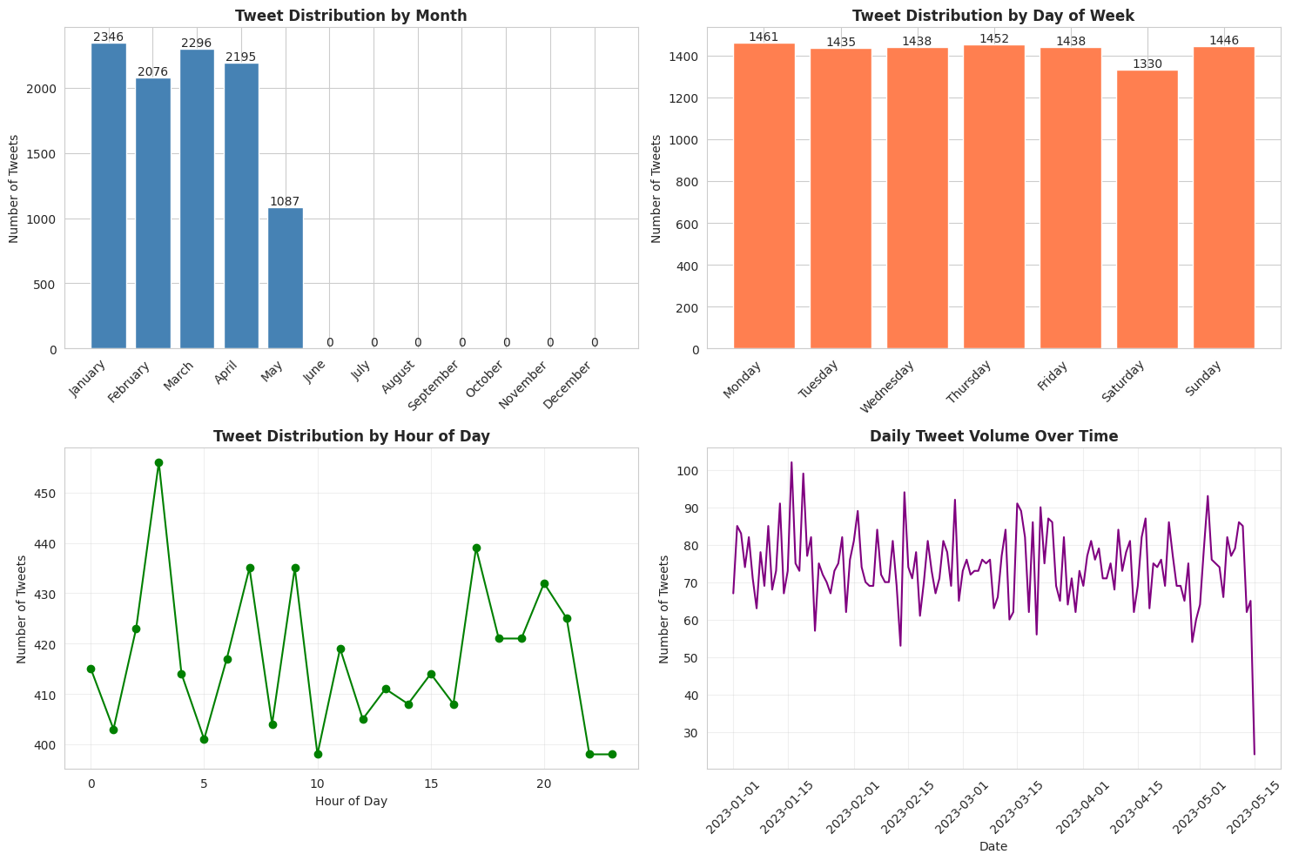
Exploratory Data Analysis
Dataset Overview
10,000 posts over 134 days (Jan 1 - May 15, 2023).
Content Profile (A "Closed Garden"
Avg. length: 34 words (Highly consistent, StdDev 5.53).
0% Mentions (@), 0% Hashtags (#), 0% URLs (http://).
User Activity (The "Wide, Shallow" Discourse
10,000 posts from 9,447 unique users.
Avg. posts per user: 1.06.
No "power users": Max posts by a single user was only 6.
Temporal & Engagement Profile
Extremely stable 24/7/365 posting pattern (no organic peaks/valleys).
High and stable engagement (Avg. ~50 likes & ~50 retweets).
Notes:
Before we could analyze what people were saying, we had to understand the fundamental shape of the data itself. This Exploratory Data Analysis, or EDA, was crucial, and it revealed some very important characteristics about our dataset.
First, the content profile. We're looking at 10,000 posts over a 134-day period. As you can see, the content is extremely clean. The average post length is 34 words, and the standard deviation is tiny, which means almost all posts are this length. Most importantly, there are zero mentions, zero hashtags, and zero URLs. This told us we are analyzing a "closed garden"—a clean, text-only dataset. This is a huge advantage, as it means our analysis can be 100% focused on the textual content without being distracted by external links or complex user interactions.
Second, and most importantly, the user activity. This was our single most significant finding. Out of 10,000 posts, we have 9,447 unique users. This means almost every post is from a different person. The average posts per user is 1.06. Even the most active user in the entire 5-month period only posted 6 times. This is critical: it means we are not analyzing a typical social media 'community' dominated by a few loud 'power users.' Instead, we are analyzing a very 'wide and shallow' discourse—a massive collection of individual statements. There is no loud minority skewing our results.
Finally, the temporal profile. The posting activity is almost perfectly uniform, 24 hours a day, 7 days a week. We don't see the organic 'peaks and valleys' you'd expect from human behavior, like more posts in the evening or fewer at 3 AM. This, combined with the stable engagement numbers, confirms that our dataset is incredibly well-balanced and not skewed by a single "viral" event or time of day.
So, to summarize our EDA: We are working with a high-quality, balanced, text-only dataset of 10,000 individual statements from nearly 10,000 different people. This "wide, shallow" structure is perfect for our analysis, as it means the sentiment and topics we find are truly representative of the entire group, not just a few active users.
With that understanding, our first step was to analyze the emotional tone of these 10,000 posts.

Slide 5
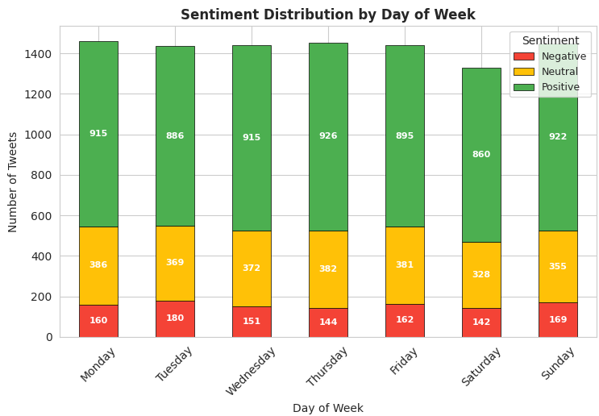
Findings: Sentiment Analysis
Summary
The overall discourse is overwhelmingly positive.
This suggests a generally stable and favorable environment, not a crisis.
Key Statistics from our Analysis
63.19% Positive: Majority of the conversation.
11.08% Negative: A very small fraction, representing a low-risk baseline.
25.73% Mixed / Neutral: A significant portion of the discourse is nuanced, thoughtful, or not emotionally charge
Notes:
Our first major finding is from the sentiment analysis. As you can see, the conversation is overwhelmingly positive, at 63.19%. Negative sentiment is remarkably low, at just 11.08%. This is a crucial finding because it immediately tells us the environment is stable and favourable. That 11% figure isn't a sign of a crisis; it's a healthy baseline that we can now monitor. We also see a large 'Mixed/Neutral' block, which points to a high level of nuanced discussion.

Slide 6
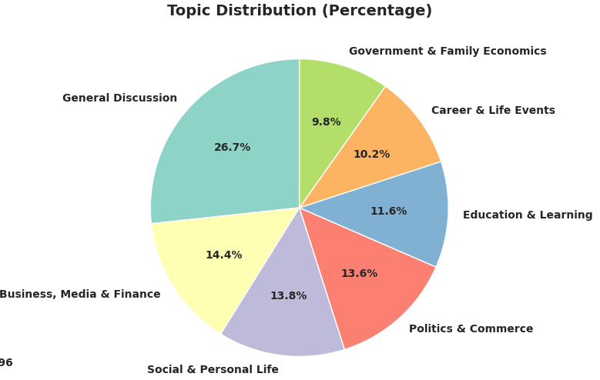
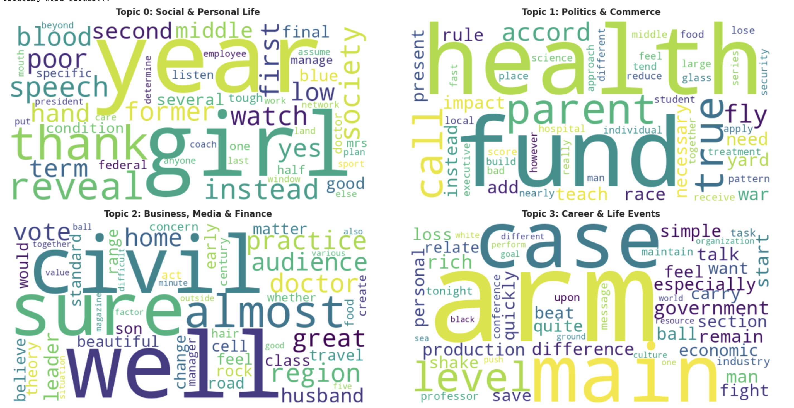
Findings: Topic Modeling
Overview
Our BERTopic model identified several distinct themes within the discourse.
Dominant Theme: A large, central theme we labelled "General Discussion" emerged.
Interpretation
This "General Discussion" topic acts as the main hub of the conversation. It contains the highest volume of posts and is strongly associated with the dominant positive sentiment. Other, smaller topics (e.g., "Policy Questions," "Support Issues") branched off from this central hub.
Notes:
When we analyzed what people were talking about, our topic model found one clear, dominant theme, which we labelled 'General Discussion.' This topic was the center of gravity for the entire dataset. It had the most posts and, as we'll see, was strongly linked to the positive sentiment we just discussed. Other, smaller, more specific topics were also identified, but this 'General Discussion' hub was the most important finding

Slide 7
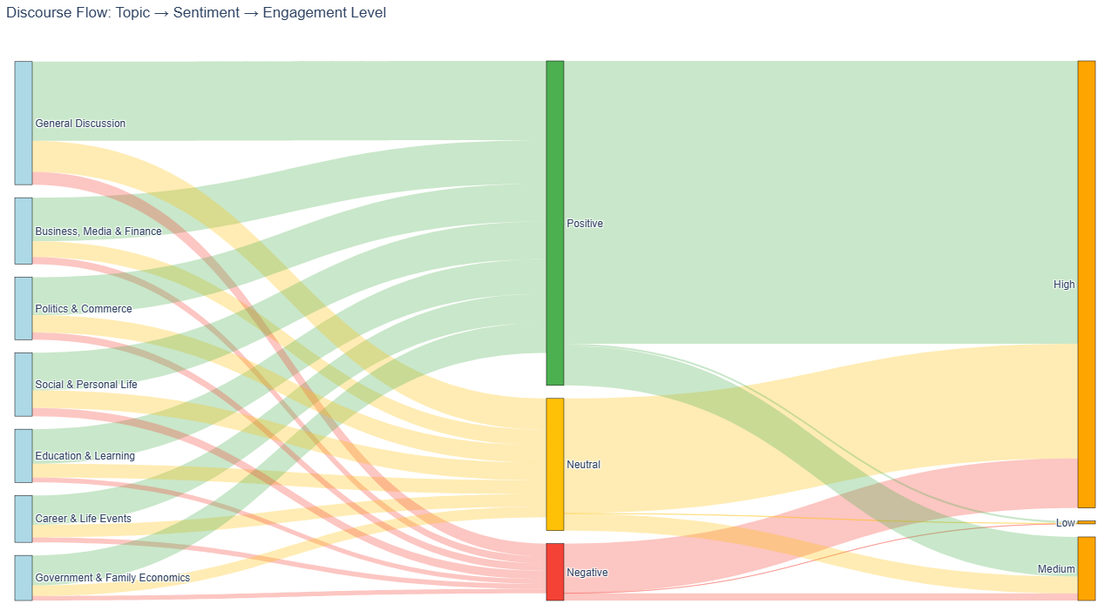
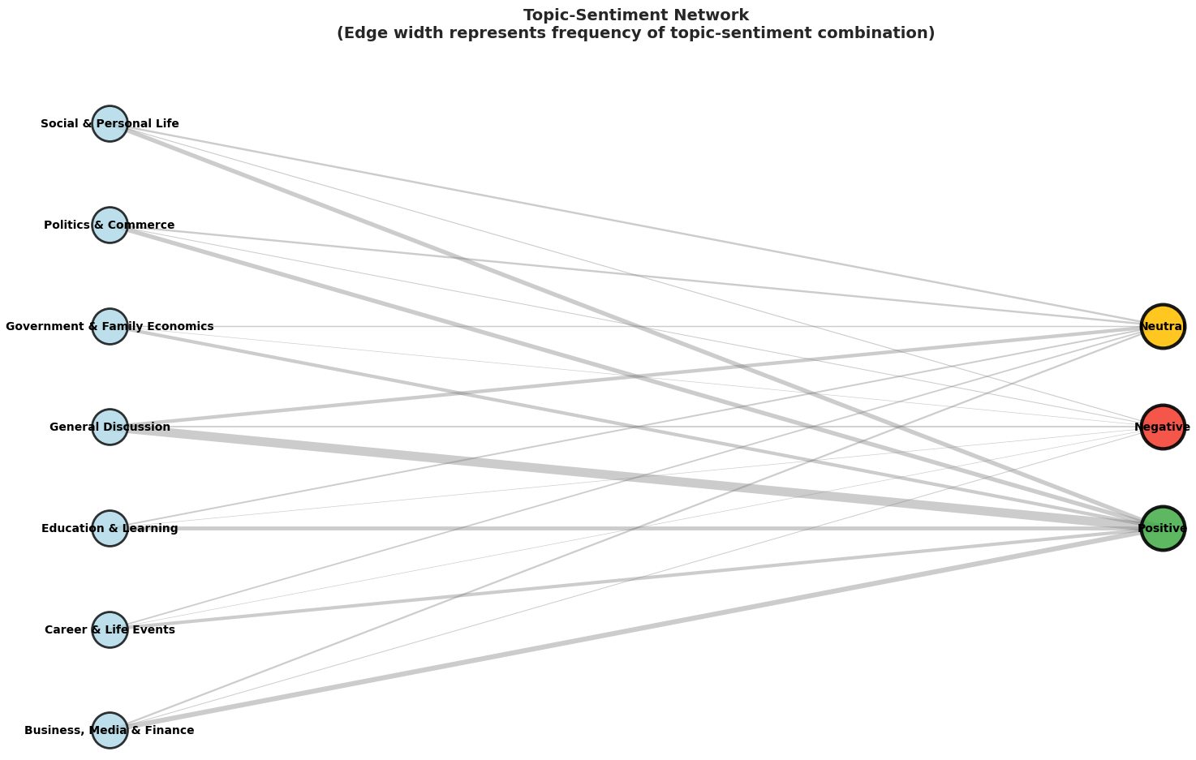
Findings: Knowledge Mapping
Summary
This is the core of our analysis: connecting sentiment to topics.
Primary Insight: We did not find "angry topics" and "happy topics."
Instead, we found that the "MIXED" sentiment profile was consistently present across all topics.
Interpretation
The discourse is nuanced and complex.
Even within the "General Discussion" hub, people are having thoughtful, mixed-emotion conversations.
This is a sign of a mature, engaged community, not an echo chamber
Topics vary in emotional intensity, bridging diverse conversation areas effectively.
Notes:
This slide shows our most important insight. We combined our previous two findings to create a discourse map. We expected to find 'angry topics' and 'happy topics,' but we didn't. Instead, our key finding was that the 'Mixed' sentiment profile was spread across all topics. This tells us the conversation is highly nuanced. Even in the main positive hub, people are expressing complex, thoughtful opinions. This is a sign of a healthy, mature community, not a polarized one.

Slide 8
Recommendations
Prioritise and Reinforce
Focus content creation on the "General Discussion" theme. Since it's large and positive, this is the area to "double down" on to maintain the 63.19% positive baseline.
Establish KPIs and Monitor
Use 11.08% (Negative) as the key baseline metric to monitor. The goal is not to eliminate it, but to ensure it remains stable. A rapid spike above this level would trigger an alert.
Rapid Response Protocol
While risk is low, a protocol should be in place to monitor influential users and engage quickly if negative sentiment begins to cluster.
Embrace Nuance
Use the "MIXED" profile as a source of insight. These are engaged users. Publish transparent, positive policy updates to address the nuanced questions they are raising.
Notes:
Our analysis leads directly to these four actionable recommendations. First, since the 'General Discussion' topic is so large and positive, we recommend prioritizing content that aligns with it. Second, that 11.08% negative rate is now your key performance indicator; the goal is to keep it stable. Third, we suggest a rapid-response protocol for influential users, just to be safe. And finally, don't ignore the 'Mixed' profile. These are your most engaged users; embrace their nuance by publishing transparent, positive updates to answer their questions.

Slide 9
Limitations and Future Research
Limitations
Cascade and Influence Analysis
Our analysis was text-only, ignoring images, videos, and linked content which add crucial context.
The analysis is a static snapshot in time, not a live, real-time monitor.
Map how information propagates from influential users.
Multimodal Analysis
Real-Time Dashboard:
Incorporate image and video analysis.
Convert this static analysis into a live monitoring tool to track our KPIs (like the 11.08% negative rate) in real time.
Notes:
It's important to be transparent about our limitations. Our analysis was focused only on text, and it's a static snapshot of a specific time period. This leads directly to our suggestions for future research. The next steps would be to add multimodal analysis for images, conduct a cascade analysis to see how information spreads, and, most powerfully, to build a real-time dashboard to monitor the KPIs we identified

Slide 10

Q&A
References
Zulu, N. and Nkuna, T. (2022) Data modelling of subsistence retail consumer purchase behavior in South Africa.

